Slide 1

Chapter 3: roadmap
Transport-layer services
Multiplexing and demultiplexing
Connectionless transport: UDP
Principles of reliable data transfer
Connection-oriented transport: TCP
Principles of congestion control
TCP congestion control
Evolution of transport-layer functionality

Slide 2
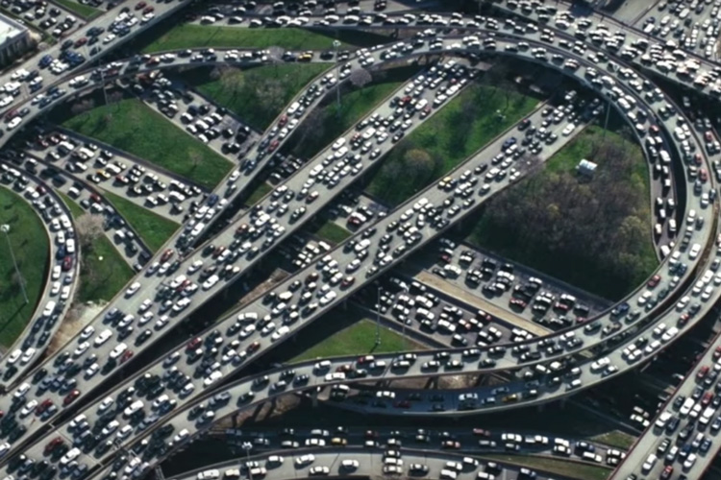


Principles of congestion control
Congestion:
informally: “too many sources sending too much data too fast for network to handle”
manifestations:
long delays (queueing in router buffers)
packet loss (buffer overflow at routers)
different from flow control!
congestion control: too many senders, sending too fast
a top-10 problem!
flow control: one sender too fast for one receiver

Slide 3

Causes/costs of congestion: scenario 1
original data: λ_{in}
throughput: λ_{out}
Simplest scenario:
Host A
one router, infinite buffers
input, output link capacity: R
infinite shared output link buffers
two flows
R
R
no retransmissions needed
Host B
R/2
Q: What happens as arrival rate λ_{in} approaches R/2?
λ_{out}
delay
throughput:
λ_{in}
R/2
λ_{in}
R/2
maximum per-connection throughput: R/2
large delays as arrival rate λ_{in} approaches capacity
R/2

Slide 4
Causes/costs of congestion: scenario 2
one router, finite buffers
sender retransmits lost, timed-out packet
application-layer input = application-layer output: λ_{in} = λ_{out}
transport-layer input includes retransmissions : λ’_{in} λ_{in}
Host A
λ_{in} : original data
λ'_{in}: original data, plus retransmitted data
λ_{out}
R
R
Host B
finite shared output link buffers

Slide 5
Causes/costs of congestion: scenario 2
Idealization: perfect knowledge
sender sends only when router buffers available
R/2
λ_{out}
throughput:
Host A
λ_{in} : original data
λ_{in}
copy
λ'_{in}: original data, plus retransmitted data
λ_{out}
R/2
free buffer space!
R
R
Host B
finite shared output link buffers

Slide 6

Causes/costs of congestion: scenario 2
Idealization: some perfect knowledge
packets can be lost (dropped at router) due to full buffers
sender knows when packet has been dropped: only resends if packet known to be lost
Host A
λ_{in} : original data
copy
λ'_{in}: original data, plus retransmitted data
no buffer space!
R
R
Host B
finite shared output link buffers

Slide 7
Causes/costs of congestion: scenario 2
Idealization: some perfect knowledge
packets can be lost (dropped at router) due to full buffers
sender knows when packet has been dropped: only resends if packet known to be lost
R/2
λ_{out}
“wasted” capacity due to retransmissions
when sending at R/2, some packets are needed retransmissions
throughput:
Host A
λ_{in} : original data
λ_{in}
λ'_{in}: original data, plus retransmitted data
R/2
free buffer space!
R
R
Host B
finite shared output link buffers

Slide 8


Causes/costs of congestion: scenario 2
Realistic scenario: un-needed duplicates
packets can be lost, dropped at router due to full buffers – requiring retransmissions
but sender times can time out prematurely, sending two copies, both of which are delivered
R/2
λ_{out}
“wasted” capacity due to un-needed retransmissions
throughput:
when sending at R/2, some packets are retransmissions, including needed and un-needed duplicates, that are delivered!
Host A
λ_{in} : original data
λ_{in}
copy
λ'_{in}: original data, plus retransmitted data
R/2
timeout
free buffer space!
R
R
Host B
finite shared output link buffers

Slide 9
Causes/costs of congestion: scenario 2
Realistic scenario: un-needed duplicates
packets can be lost, dropped at router due to full buffers – requiring retransmissions
but sender times can time out prematurely, sending two copies, both of which are delivered
R/2
λ_{out}
“wasted” capacity due to un-needed retransmissions
throughput:
when sending at R/2, some packets are retransmissions, including needed and un-needed duplicates, that are delivered!
λ_{in}
R/2
“costs” of congestion:
more work (retransmission) for given receiver throughput
unneeded retransmissions: link carries multiple copies of a packet
decreasing maximum achievable throughput

Slide 10
Causes/costs of congestion: scenario 3
four senders
multi-hop paths
timeout/retransmit
Q: what happens as λ_{in} and λ_{in}’ increase ?
A: as red λ_{in}’ increases, all arriving blue pkts at upper queue are dropped, blue throughput g 0
Host A
λ_{in} : original data
λ'_{in}: original data, plus retransmitted data
Host B
finite shared output link buffers
Host D
λ_{out}
Host C

Slide 11
Causes/costs of congestion: scenario 3
R/2
λ_{out}
λ_{in}’
R/2
another “cost” of congestion:
when packet dropped, any upstream transmission capacity and buffering used for that packet was wasted!

Slide 12
Causes/costs of congestion: insights
throughput can never exceed capacity
delay increases as capacity approached
loss/retransmission decreases effective throughput
un-needed duplicates further decreases effective throughput
upstream transmission capacity / buffering wasted for packets lost downstream

Slide 13
Approaches towards congestion control
End-end congestion control:
no explicit feedback from network
congestion inferred from observed loss, delay
ACKs
data
data
ACKs
approach taken by TCP

Slide 14
Approaches towards congestion control
Network-assisted congestion control:
routers provide direct feedback to sending/receiving hosts with flows passing through congested router
may indicate congestion level or explicitly set sending rate
explicit congestion info
ACKs
data
data
ACKs
TCP ECN, ATM, DECbit protocols

Slide 15
Chapter 3: roadmap
Transport-layer services
Multiplexing and demultiplexing
Connectionless transport: UDP
Principles of reliable data transfer
Connection-oriented transport: TCP
Principles of congestion control
TCP congestion control
Evolution of transport-layer functionality

Slide 16
TCP congestion control: AIMD
approach: senders can increase sending rate until packet loss (congestion) occurs, then decrease sending rate on loss event
Additive Increase
Multiplicative Decrease
increase sending rate by 1 maximum segment size every RTT until loss detected
cut sending rate in half at each loss event
AIMD sawtooth
behavior: probing
for bandwidth
TCP sender Sending rate
time

Slide 17
TCP AIMD: more
Multiplicative decrease detail: sending rate is
Cut in half on loss detected by triple duplicate ACK (TCP Reno)
Cut to 1 MSS (maximum segment size) when loss detected by timeout (TCP Tahoe)
Why AIMD?
AIMD – a distributed, asynchronous algorithm – has been shown to:
optimize congested flow rates network wide!
have desirable stability properties

Slide 18
TCP congestion control: details
sender sequence number space
TCP sending behavior:
roughly: send cwnd bytes, wait RTT for ACKS, then send more bytes
cwnd
last byte
ACKed
cwnd
sent, but not-yet ACKed
(“in-flight”)
available but not used
TCP rate
~
bytes/sec
~
RTT
last byte sent
TCP sender limits transmission:
cwnd is dynamically adjusted in response to observed network congestion (implementing TCP congestion control)
<
cwnd
LastByteSent- LastByteAcked

Slide 19
TCP slow start
Host A
Host B
when connection begins, increase rate exponentially until first loss event:
initially cwnd = 1 MSS
double cwnd every RTT
done by incrementing cwnd for every ACK received
one segment
RTT
two segments
four segments
summary: initial rate is slow, but ramps up exponentially fast
time

Slide 20
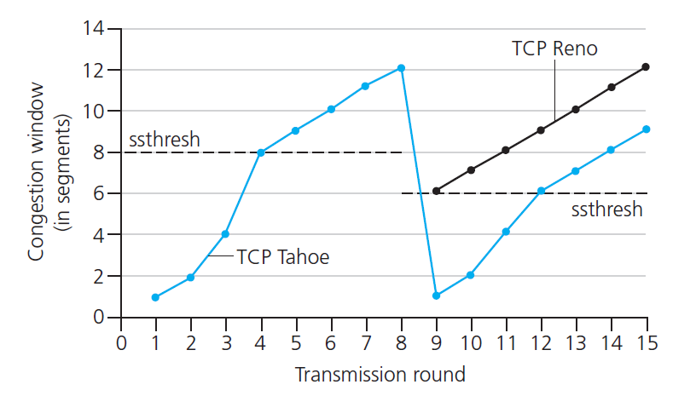

TCP: from slow start to congestion avoidance
Q: when should the exponential increase switch to linear?
A: when cwnd gets to 1/2 of its value before timeout.
X
Implementation:
variable ssthresh
on loss event, ssthresh is set to 1/2 of cwnd just before loss event
* Check out the online interactive exercises for more examples: http://gaia.cs.umass.edu/kurose_ross/interactive/

Slide 21
Summary: TCP congestion control
New
ACK!
New
ACK!
.
duplicate ACK
new ACK
dupACKcount++
new ACK
cwnd = cwnd + MSS (MSS/cwnd)
dupACKcount = 0
transmit new segment(s), as allowed
cwnd = cwnd+MSS
dupACKcount = 0
transmit new segment(s), as allowed
Λ
cwnd = 1 MSS
ssthresh = 64 KB
dupACKcount = 0
cwnd > ssthresh
slow
start
Λ
congestion
avoidance
timeout
ssthresh = cwnd/2
cwnd = 1 MSS
dupACKcount = 0
retransmit missing segment
duplicate ACK
timeout
dupACKcount++
ssthresh = cwnd/2
cwnd = 1 MSS
dupACKcount = 0
retransmit missing segment
timeout
New
ACK!
ssthresh = cwnd/2
cwnd = 1
dupACKcount = 0
retransmit missing segment
New ACK
dupACKcount == 3
cwnd = ssthresh
dupACKcount = 0
dupACKcount == 3
ssthresh= cwnd/2
cwnd = ssthresh + 3
retransmit missing segment
ssthresh= cwnd/2
cwnd = ssthresh + 3
retransmit missing segment
fast
recovery
duplicate ACK
cwnd = cwnd + MSS
transmit new segment(s), as allowed

Slide 22
TCP CUBIC
Is there a better way than AIMD to “probe” for usable bandwidth?
Insight/intuition:
W_{max}: sending rate at which congestion loss was detected
congestion state of bottleneck link probably (?) hasn’t changed much
after cutting rate/window in half on loss, initially ramp to to W_{max} faster, but then approach W_{max} more slowly
W_{max}
classic TCP
TCP CUBIC - higher throughput in this example
W_{max}/2

Slide 23
TCP CUBIC
K: point in time when TCP window size will reach W_{max}
K itself is tuneable
increase W as a function of the cube of the distance between current time and K
larger increases when further away from K
smaller increases (cautious) when nearer K
TCP CUBIC default in Linux, most popular TCP for popular Web servers
W_{max}
TCP Reno
TCP CUBIC
TCP
sending
rate
time
t₀
t₁
t₂
t₃
t₄

Slide 24
TCP and the congested “bottleneck link”
TCP (classic, CUBIC) increase TCP’s sending rate until packet loss occurs at some router’s output: the bottleneck link
source
destination
application
TCP
network
link
physical
application
TCP
network
link
physical
packet queue almost never empty, sometimes overflows packet (loss)
bottleneck link (almost always busy)

Slide 25
TCP and the congested “bottleneck link”
TCP (classic, CUBIC) increase TCP’s sending rate until packet loss occurs at some router’s output: the bottleneck link
understanding congestion: useful to focus on congested bottleneck link
insight: increasing TCP sending rate will not increase end-end throughout with congested bottleneck
source
destination
application
TCP
network
link
physical
application
TCP
network
link
physical
insight: increasing TCP sending rate will increase measured RTT
Goal: “keep the end-end pipe just full, but not fuller”
RTT

Slide 26
Delay-based TCP congestion control
Keeping sender-to-receiver pipe “just full enough, but no fuller”: keep bottleneck link busy transmitting, but avoid high delays/buffering
# bytes sent in last RTT interval
RTT_{measured}
measured
throughput
=
RTT_{measured}
Delay-based approach:
RTT_{min} - minimum observed RTT (uncongested path)
uncongested throughput with congestion window cwnd is cwnd/RTT_{min}
if measured throughput “very close” to uncongested throughput
increase cwnd linearly /* since path not congested */
else if measured throughput “far below” uncongested throughout
decrease cwnd linearly /* since path is congested */

Slide 27
Delay-based TCP congestion control
congestion control without inducing/forcing loss
maximizing throughout (“keeping the just pipe full… ”) while keeping delay low (“…but not fuller”)
a number of deployed TCPs take a delay-based approach
BBR deployed on Google’s (internal) backbone network

Slide 28
Explicit congestion notification (ECN)
TCP deployments often implement network-assisted congestion control:
two bits in IP header (ToS field) marked by network router to indicate congestion
policy to determine marking chosen by network operator
congestion indication carried to destination
destination sets ECE bit on ACK segment to notify sender of congestion
involves both IP (IP header ECN bit marking) and TCP (TCP header C,E bit marking)
source
TCP ACK segment
destination
application
TCP
network
link
physical
application
TCP
network
link
physical
ECE=1
ECN=10
ECN=11
IP datagram

Slide 29
TCP fairness
Fairness goal: if K TCP sessions share same bottleneck link of bandwidth R, each should have average rate of R/K
TCP connection 1
bottleneck
router
capacity R
TCP connection 2

Slide 30
Q: is TCP Fair?
Example: two competing TCP sessions:
additive increase gives slope of 1, as throughout increases
multiplicative decrease decreases throughput proportionally
R
equal bandwidth share
Is TCP fair?
A: Yes, under idealized assumptions:
same RTT
fixed number of sessions only in congestion avoidance
loss: decrease window by factor of 2
congestion avoidance: additive increase
Connection 2 throughput
loss: decrease window by factor of 2
congestion avoidance: additive increase
Connection 1 throughput
R

Slide 31
Fairness: must all network apps be “fair”?
Fairness and UDP
multimedia apps often do not use TCP
do not want rate throttled by congestion control
instead use UDP:
send audio/video at constant rate, tolerate packet loss
there is no “Internet police” policing use of congestion control
Fairness, parallel TCP connections
application can open multiple parallel connections between two hosts
web browsers do this , e.g., link of rate R with 9 existing connections:
new app asks for 1 TCP, gets rate R/10
new app asks for 11 TCPs, gets R/2

Slide 32
Transport layer: roadmap
Transport-layer services
Multiplexing and demultiplexing
Connectionless transport: UDP
Principles of reliable data transfer
Connection-oriented transport: TCP
Principles of congestion control
TCP congestion control
Evolution of transport-layer functionality

Slide 33
Evolving transport-layer functionality
TCP, UDP: principal transport protocols for 40 years
different “flavors” of TCP developed, for specific scenarios:
Scenario | Challenges
Long, fat pipes (large data transfers) | Many packets “in flight”; loss shuts down pipeline
Wireless networks | Loss due to noisy wireless links, mobility; TCP treat this as congestion loss
Long-delay links | Extremely long RTTs
Data center networks | Latency sensitive
Background traffic flows | Low priority, “background” TCP flows
moving transport–layer functions to application layer, on top of UDP
HTTP/3: QUIC

Slide 34
QUIC: Quick UDP Internet Connections
application-layer protocol, on top of UDP
increase performance of HTTP
deployed on many Google servers, apps (Chrome, mobile YouTube app)
HTTP/2
HTTP/2 (slimmed)
Application
HTTP/3
TLS
QUIC
Transport
TCP
UDP
Network
IP
IP
HTTP/2 over TCP
HTTP/2 over QUIC over UDP

Slide 35
QUIC: Quick UDP Internet Connections
adopts approaches we’ve studied in this chapter for connection establishment, error control, congestion control
error and congestion control: “Readers familiar with TCP’s loss detection and congestion control will find algorithms here that parallel well-known TCP ones.” [from QUIC specification]
connection establishment: reliability, congestion control, authentication, encryption, state established in one RTT
multiple application-level “streams” multiplexed over single QUIC connection
separate reliable data transfer, security
common congestion control

Slide 36
QUIC: Connection establishment
TCP handshake
(transport layer)
QUIC handshake
data
TLS handshake
(security)
data
TCP (reliability, congestion control state) + TLS (authentication, crypto state)
2 serial handshakes
QUIC: reliability, congestion control, authentication, crypto state
1 handshake

Slide 37
QUIC: streams: parallelism, no HOL blocking
HTTP
GET
HTTP
GET
HTTP
GET
HTTP
GET
HTTP
GET
application
HTTP
GET
QUIC
encrypt
QUIC
encrypt
QUIC
encrypt
QUIC
encrypt
QUIC
encrypt
QUIC
encrypt
TLS encryption
TLS encryption
QUIC
RDT
QUIC
RDT
QUIC
RDT
QUIC
RDT
QUIC
RDT
QUIC
RDT
error!
QUIC Cong. Cont.
QUIC Cong. Cont.
TCP RDT
TCP RDT
error!
transport
TCP Cong. Contr.
TCP Cong. Contr.
UDP
UDP
(a) HTTP 1.1
(b) HTTP/2 with QUIC: no HOL blocking

Slide 38
Chapter 3: summary
principles behind transport layer services:
multiplexing, demultiplexing
reliable data transfer
flow control
congestion control
instantiation, implementation in the Internet
UDP
TCP
Up next:
leaving the network “edge” (application, transport layers)
into the network “core”
two network-layer chapters:
data plane
control plane

